Slide 1
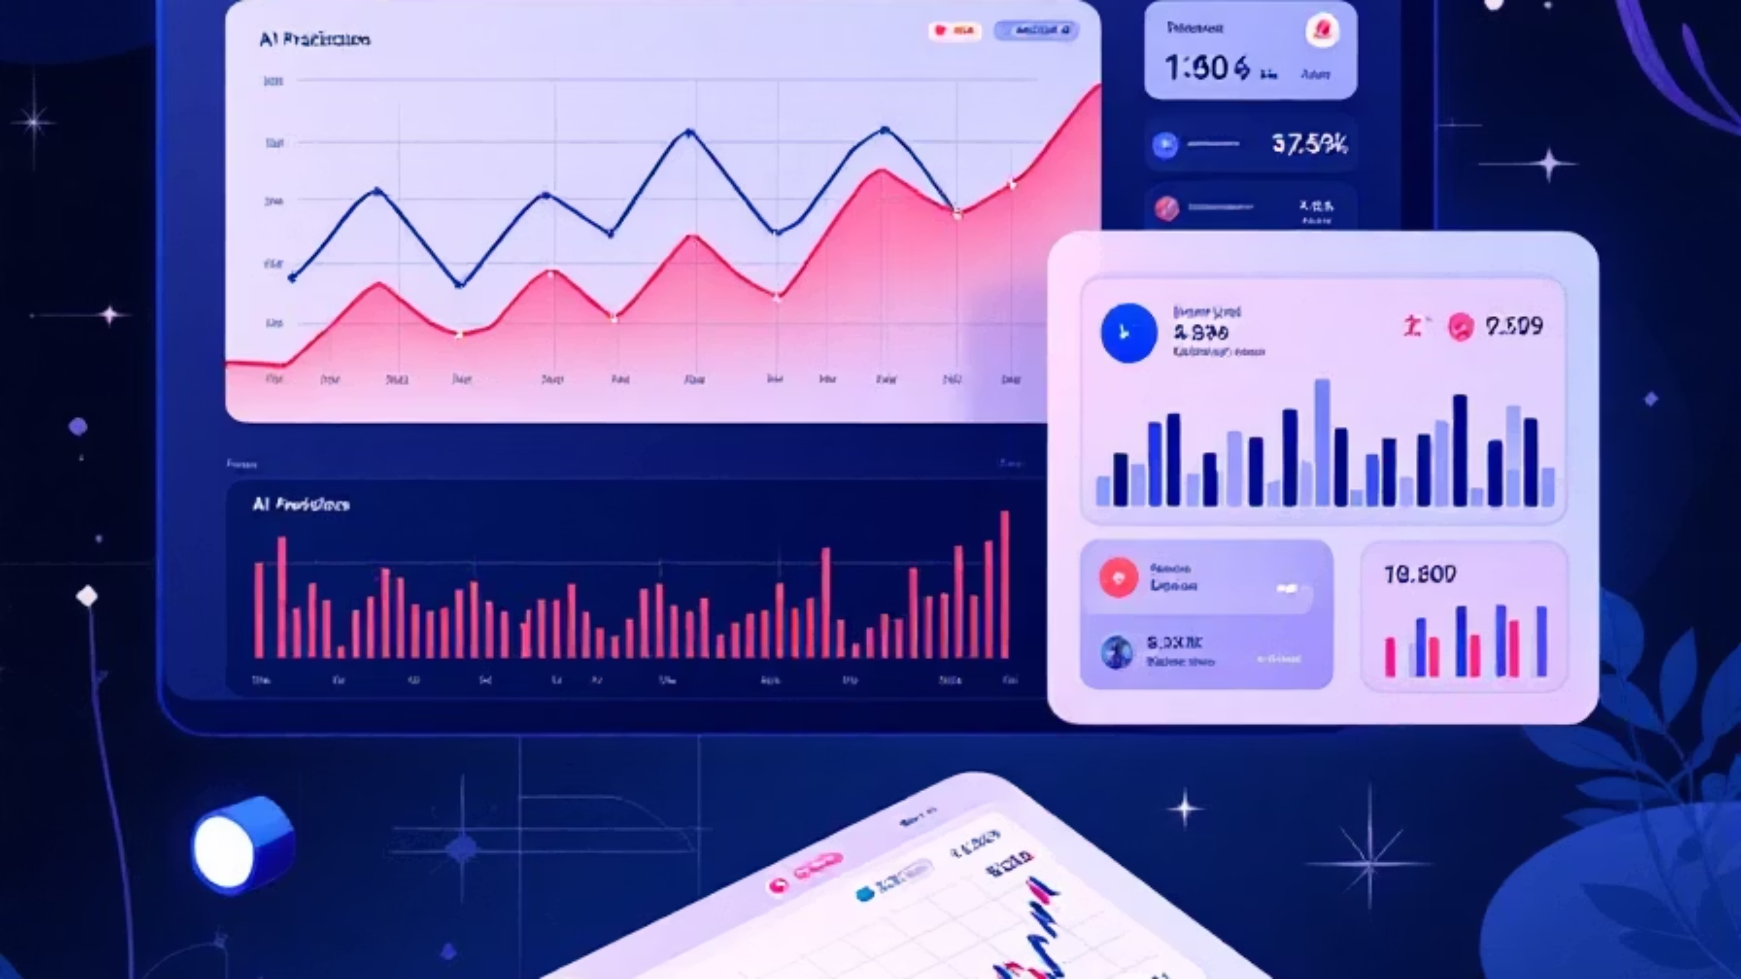
Stock Prediction: The AI Advantage
Unlocking unparalleled financial foresight through advanced AI and web-native analytics.
Presented by: Sachin Kumar

Slide 2




Project Vision and Core Objectives
1
Vision: Intelligent Financial Insights
To create a secure, user-friendly, and intelligent web platform that demystifies stock market analysis by providing AI-driven predictions, rich data visualisations, and natural language interaction.
Full-Stack Development
AI-Powered Prediction
Build a complete application with a clear separation between frontend, backend, and ML services.
Implement a robust machine learning pipeline to predict future stock movements accurately.
Rich User Experience
Conversational AI
Provide a sleek, interactive, and intuitive dark-themed user dashboard for easy analysis.
Integrate an AI chatbot to allow users to ask complex financial questions in plain English.

Slide 3
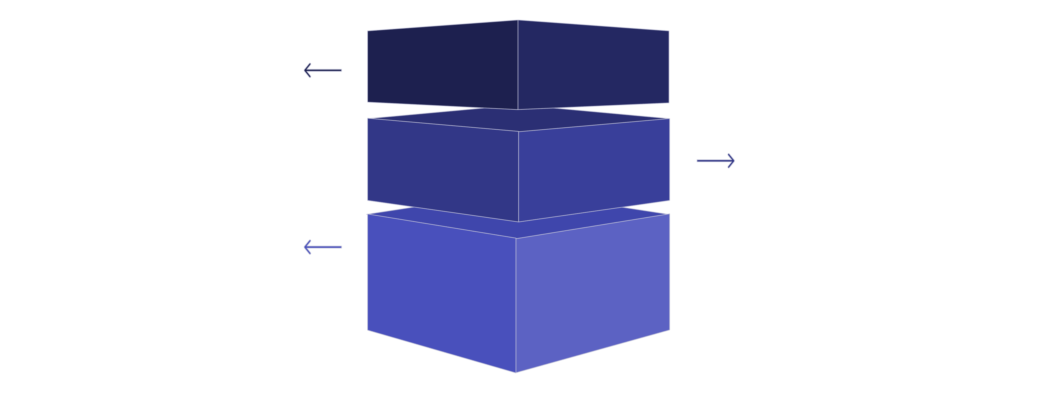
A Modern, Decoupled Three-Tier Architecture
The project employs a decoupled microservices architecture, separating the application into three independent services for improved scalability, maintainability, and overall robustness.
Frontend
User interface (React) sends requests.
Backend (Auth)
Handles authentication and session logic.
ML API
Processes requests and returns predictions.
Frontend (React) - The User Interface
Backend (Node.js) - Authentication & User Management
ML API (Python) - The Computational Engine
Renders the dashboard, manages user interactions, and communicates securely with the backend APIs.
Fetches financial data, performs all machine learning tasks, and powers the AI chatbot.
Handles user registration, login, and secure session management using JSON Web Tokens (JWT).

Slide 4
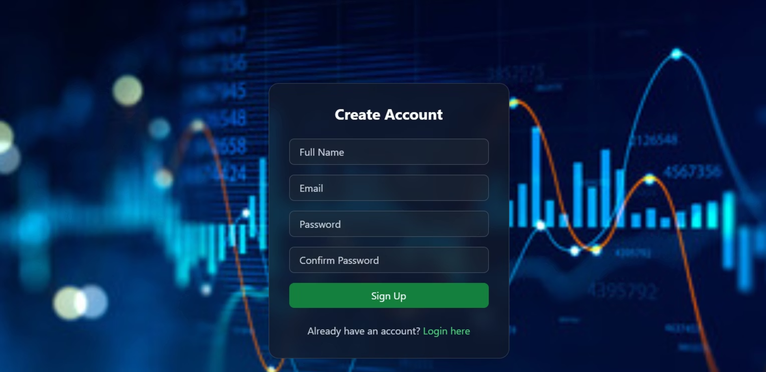


Secure Onboarding and Technology Stack
Secure & Seamless Onboarding
The user's journey begins with a professional and secure authentication process, ensuring only authorised users can access the sensitive financial dashboard.
Secure Authentication: Professional Login and Signup pages with robust validation.
Session Management: Uses JSON Web Tokens (JWT) for highly secure user sessions.
Protected Routes: The React frontend intelligently guards the dashboard, redirecting any unauthorised access attempt.
Key Technology Stack Components
Frontend
Backend (Auth)
ML & Data API
React, React Router, Tailwind CSS, Chart.js
Node.js, Express, JWT, Bcrypt for password hashing.
Python, Flask, Pandas, Scikit-learn, yfinance, Ollama.

Slide 5

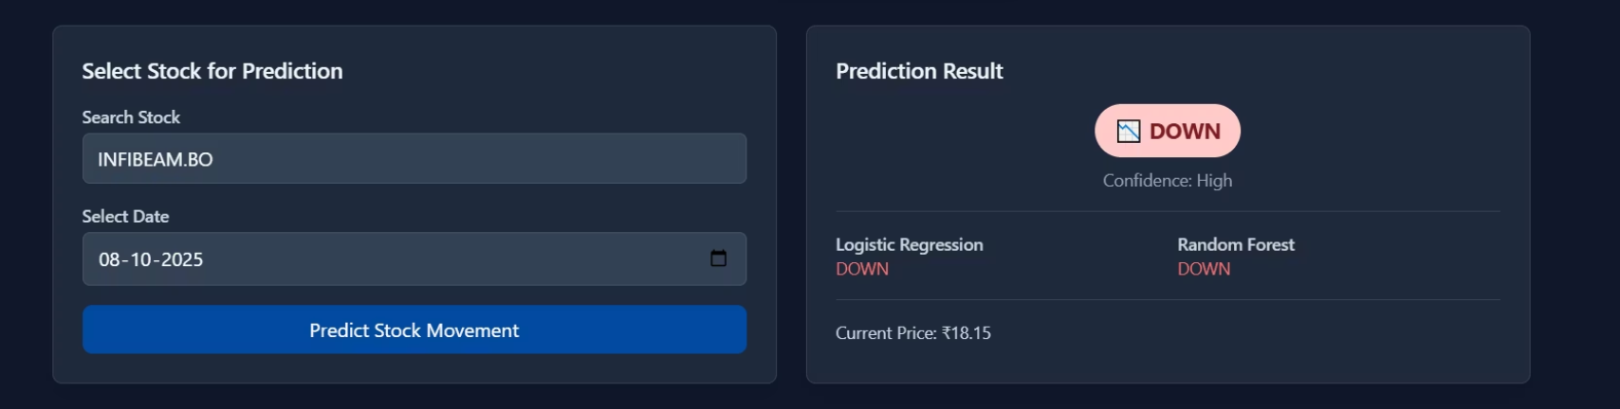
The Core: AI Prediction Engine
The application's core is a powerful machine learning pipeline that provides data-driven, quantifiable insights into future stock movements.
Dynamic Data Pipeline
Fetches the latest financial data using yfinance on every request, ensuring real-time relevance.
Advanced Feature Engineering
Automatically calculates key technical indicators like Moving Averages (MA), Relative Strength Index (RSI), and Volatility.
Ensemble Modeling
Utilises both Logistic Regression and Random Forest models for more robust, cross-validated predictions.
Clear Results
The final prediction ("UP" or "DOWN") and the model's confidence level are clearly displayed to the user.

Slide 6

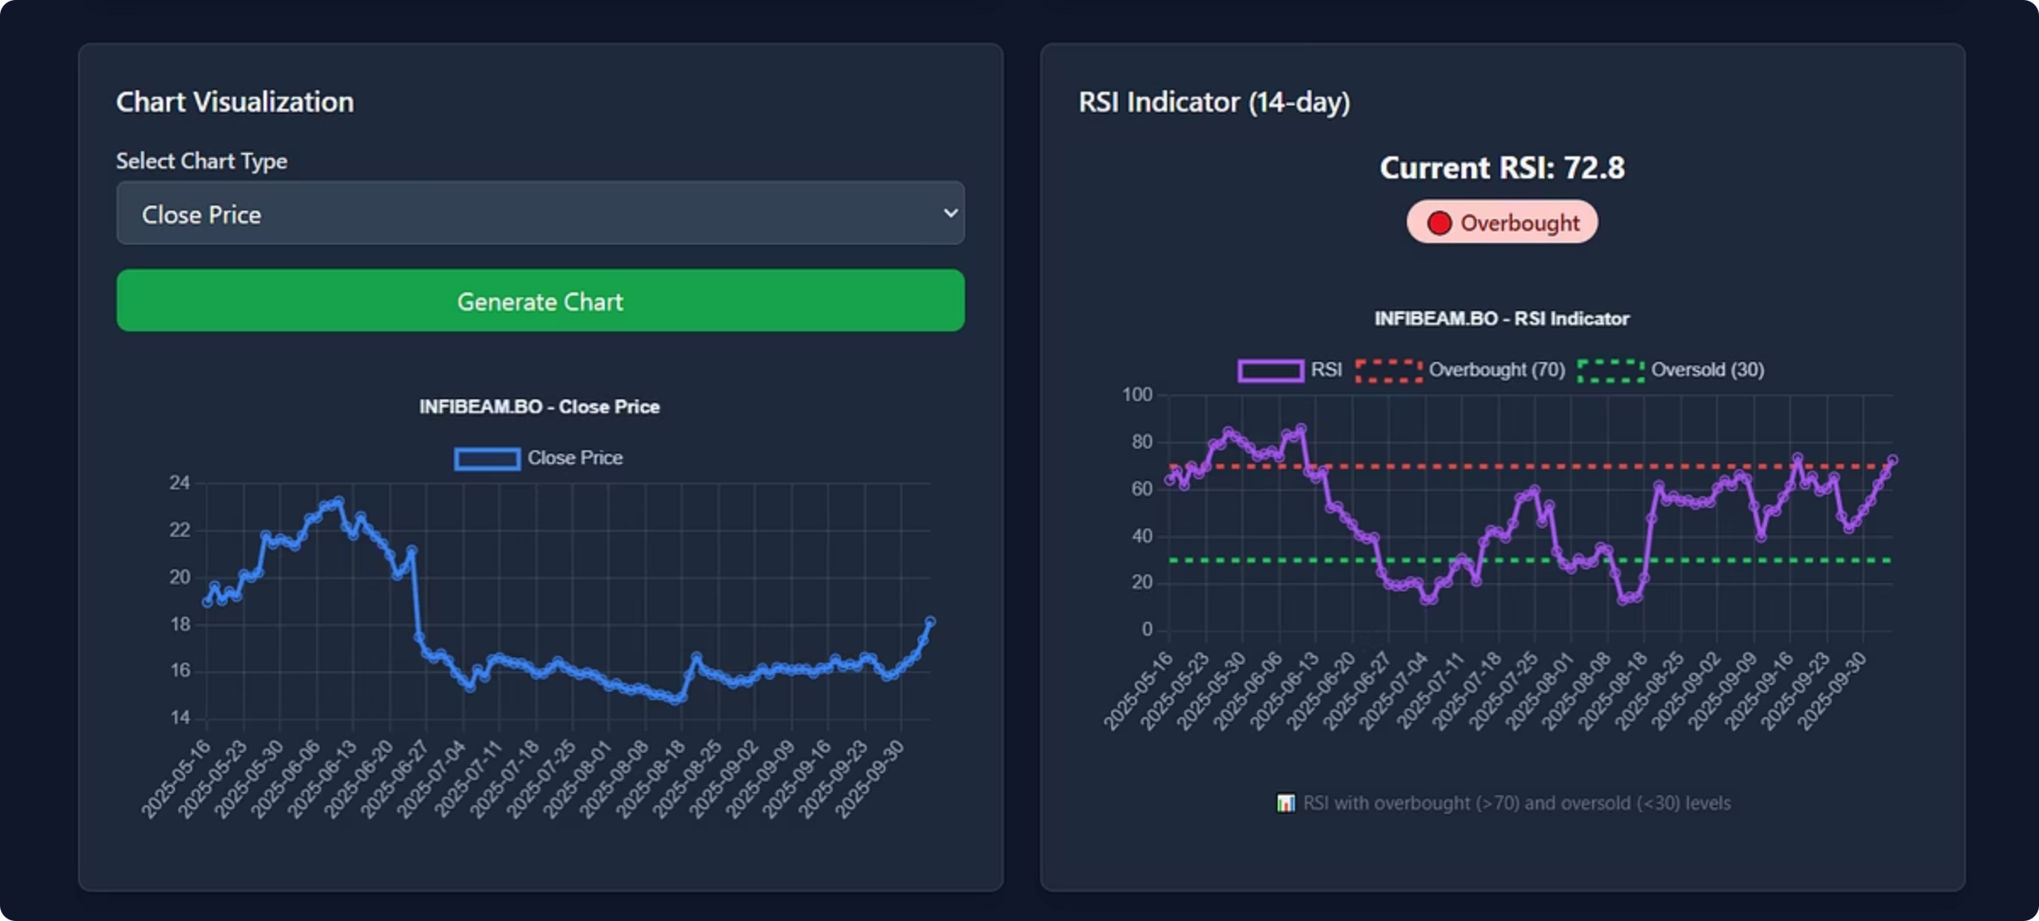



Interactive Data Visualisation
The platform brings data to life with dynamic and interactive charts, crucial for technical analysis, all styled for the preferred dark theme aesthetic.
Price & Volume
Historical price charts (Open, Close) alongside trading volume indicators.
Moving Averages
Visualisation of MA5, MA20, and MA50 to identify short and long-term trends.
RSI Indicator
Clearly marked Overbought (>70) and Oversold (<30) levels for momentum analysis.

Slide 7
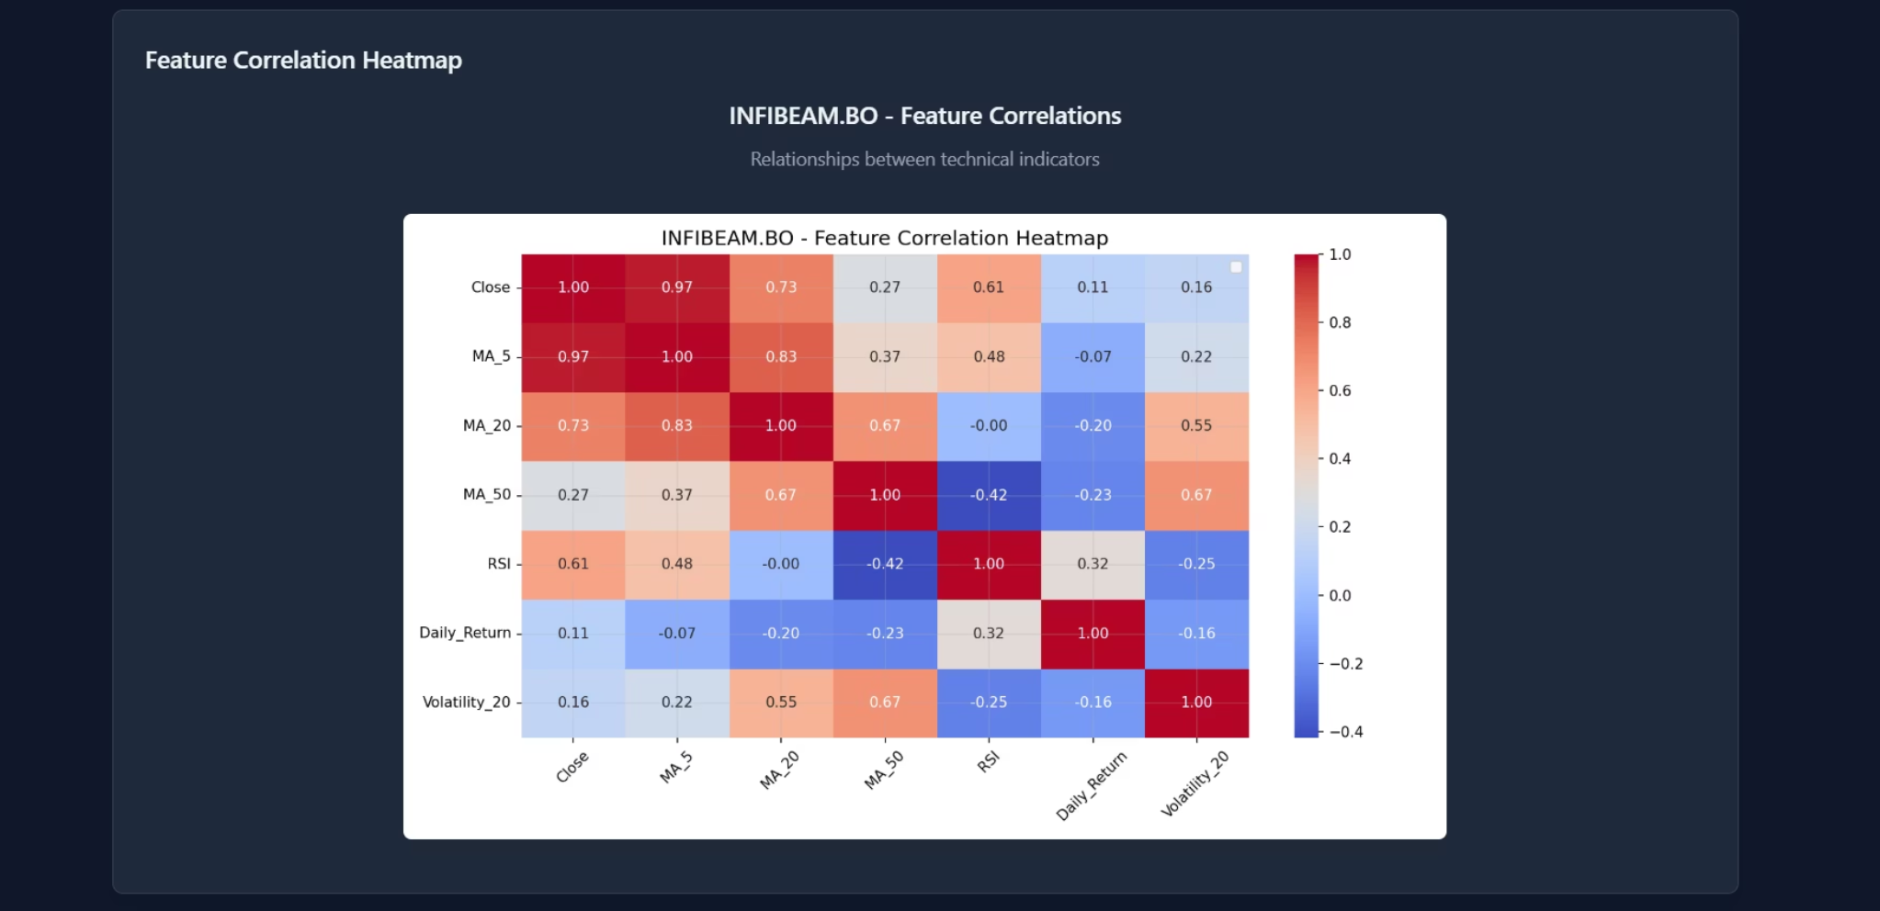
Deeper Analytical Insights: Correlation and Summary
Advanced tools help stakeholders understand the underlying data and market dynamics at a glance, providing context for the AI's prediction.
Analysis Summary Card
A scannable card presenting the most critical real-time data points from the analysis, including:
Last Close Price
Day's High/Low Range
Trading Volume
Volatility Metrics
Feature Correlation Heatmap
A visual matrix showing the statistical relationships between different technical indicators, helping to explain which factors are influencing price movements most significantly.

Slide 8
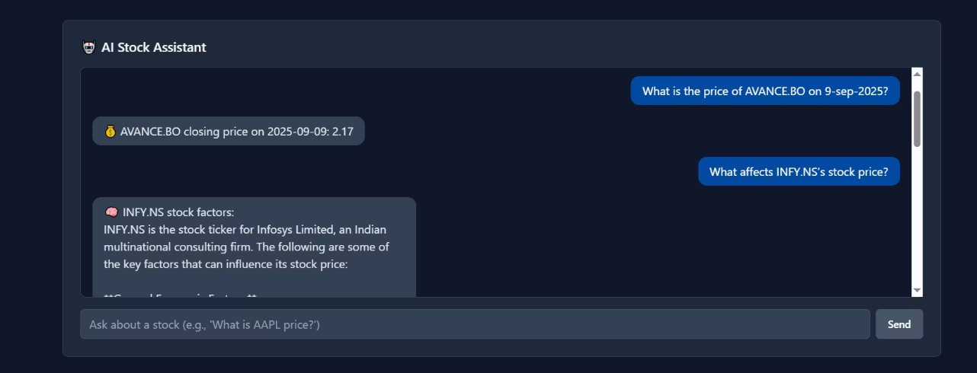


Conversational AI: The Stock Assistant
An integrated AI chatbot, powered by a local Large Language Model (Ollama/Llama3), makes complex financial data instantly accessible and conversational.
Intent Recognition
Real-time Answers
The LLM analyses the user's query to understand their intent (e.g., price check, comparison, performance metrics).
The chatbot fetches live data from yfinance in the background to provide instant, contextual, and accurate answers.

Slide 9
Conclusion & Future Scope
Project Conclusion
The "Stock Market" project successfully integrates a full-stack web application with a powerful machine learning backend. This delivers a comprehensive, intelligent, and user-friendly tool, validating the core approach to AI-driven financial analysis.
01
02
Persistent Database
Model Optimisation
Upgrade to a database like MongoDB to store user data, preferences, and custom watchlists, enhancing personalisation.
Pre-train models on historical data to significantly improve the ML API's response times and latency.
03
04
User Portfolios
Real-time Alerts
Add functionality for users to simulate and track their own stock portfolios and performance.
Develop a system to notify users immediately of significant price movements or prediction changes.

Slide 10

Thank You

